Slide 1
SQL Server 2016 Launch Roadshow
Partner Panel Discussion

Slide 2
Scope and Goals
Interactive panel discussion covering Mission Critical (Superdome), Modernization and Advanced Analytics.
Participants:
Microsoft Moderator (same person that delivers the event keynote)
HP
Data Platform SI
Advanced Analytics SI (could also be the same partner covering DP)
Format:
Pre-Determined questions from the moderator will be posed to each partner, all partners will have the opportunity to chime in on a given question.
Follow up questions from the audience
Goals
Share insights on specific solution areas from a partner perspective
Showcase partner capabilities through the sharing on tangible examples

Slide 3
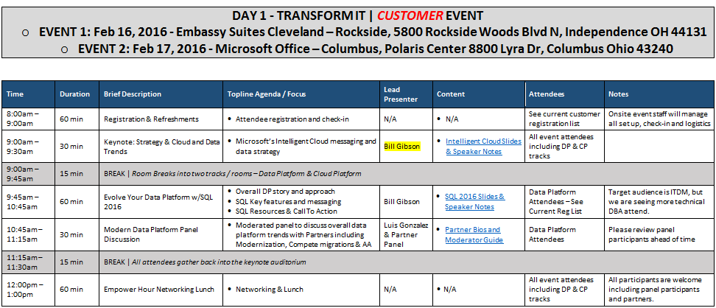
Customer Event Details

Slide 4
Roles & Responsibilities
1. Bill Gibson & Luis Gonzalez – present keynote, moderate panel discussion, network and actively participate in the day
2. Bill Gibson – lead SQL 2016 customer presentation, SQL SME for all technical questions, participate in panel discussion (optional), network and actively participate in the day
Logistics
Please arrive 30 minutes early for your session to allow time for set up
All event logistics including catering, reserving room, etc. will be coordinated already by Brenda Fix.
Issues? Questions? Contact Keith Ragland

Slide 5
Sample Questions
Advanced Analytics
We have all heard about Big Data and Advanced Analytics. Can you help make this “real” for our audience by sharing some examples of tangible solutions that you have delivered for your customers? How are they using these workloads? Most importantly, what is the value your customers are getting out of these workloads?
Sample Answer:
Over the past 5 years we have seen exponential growth in the amount of data our customers are having to manage and extract value from, but what’s driving this? Solutions that include data born in the cloud, like social data from twitter or search data from Bing are one driver. Another big trend is the use of data related to Internet of Things (IoT), particularly in manufacturing scenarios that leverage data from connected devices. With respect to the value customers are getting from these workloads , let me highlight a couple of areas:
Advanced Analytics solutions allow customers to move from the backward looking “what happened” that they get with traditional BI to a forward looking view of “What will happen” that comes with predictive analytics. When they do this, it opens up an opportunity to be drive more efficient use of the resources these customers leverage to drive their business and in doing so achieve significant competitive advantage relative market peers who don’t use AA.
For example (partner example), we helped customer X develop and deploy the following solution, the solution was aligned to their business goals in the following way and leveraged (SQL on prem, Cortana, etc.). The benefit the customer saw was Z…
The more efficient use of resources can impact a lot of different areas. For example, this could be things like marketing spend, product mix, loyalty offers or even human resources.

Slide 6
Sample Questions
Modernization
I hear a lot of talk in the industry (and today) about a “modern data platform”. What does that mean to you exactly?
Answers to touch on….
Predictive insights
Etc. etc <Need to clean these up>
Why are customers modernizing their data platform environment and what are some of the benefits companies are seeing from making this modernization step?
What are some of the key challenges customers are facing on the journey to modernizing their data platform?
What are some of the solutions or practices customers are using to help overcome these challenges?

Slide 7
Sample Questions
Where do customers start when deciding to re-platform or modernize their environment?
Answers to touch on…
Data Platform Assessment
POC
How are customers justifying the cost to re-platform and move off of Oracle or Netezza for example?
Answers to touch on…
Performance
TCO
Reduced Complexity
Consistent platform on prem/cloud/relational/beyond relational
With so much talk about the cloud, why should customers consider investing in on premise solutions (e.g. Superdome X, CS300, APS, SQL Server)?
Answers to touch on…
DB Market growth
Customers will continue to want a hybrid scenario, choice where there data resides

Slide 8
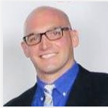
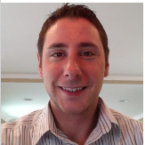
Partner Panel – Cleveland and Columbus, Feb 16&17, 2016
Vincent Staropoli – Managing Consultant, Cardinal Solutions
Vinnie is the Solution Sales Specialist and Managing Consultant in Cardinal’s Columbus office with a focus on delivering Microsoft BI solutions. As an MCSE in both Business Intelligence and Data Platform, he is responsible for architecting, implementing and supporting solutions using Microsoft technology, both on premise and in the cloud. He is active on twitter, a variety of community forums, and regularly participates in regional community events. A regular attendee and presenter at the Columbus SQL PASS chapter meetings, his presentation topics include SQL Server 2016, reporting services subscriptions customizations, PowerBI, custom Excel tools, and data mining in SQL Server 2012.
Email: vstaropoli@cardinalsolutions.com
Daniel Meyers - Solution Architect at BlueGranite
Daniel is a data professional who loves helping customers build modern and traditional data systems that help them make sense of the complex world of data. Daniel believes that all data has potential value if applied in a practical way. He has many years of experience building data solutions for small, medium, and large corporations in many different industries, and has built many traditional business intelligence systems as well as a growing number of modern data solutions. He is currently exploring all of the new cloud technologies in the data space to see how they fit together to build a modern data architecture that can solve the new data challenges that are emerging everyday.
Email: dmeyers@blue-granite.com

Slide 9
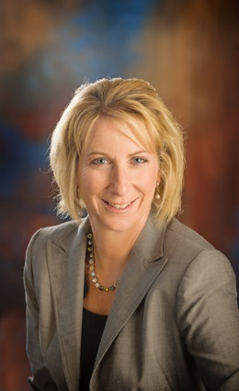
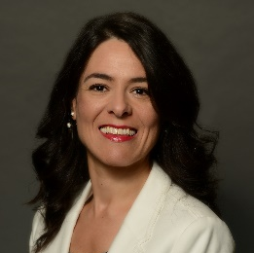
Partner Panel – Cleveland and Columbus, Feb16 & 17, 2016
Natalie Damschroder - Alliance Business Manager at HP Enterprise
Natalie Damschroder has been with HPE on the Enterprise Group Americas team for nearly seven years and has helped develop HP’s outstanding sales relationships with Microsoft. Previously, she held a variety of Sales and Business Development leadership roles at Sterling Commerce, an IBM Company and Microsoft. Natalie holds a Bachelor of Science in Business Administration from The Ohio State University. Natalie and her fiancé, Patrick live in Columbus, Ohio.
Isabel Martin – Sr. System Solution Architect at HP Enterprise
Isabel Martín has been with HPE for over 15 years, performing different technical positions in HPE Mission Critical Solutions. She has an international career, that started in Spain HPE as a Mission Critical Support Engineer. Currently she works for USA HPE as a Mission Critical Solution Architect. Throughout her career, she has supported and designed high-end architectures for databases like Microsoft SQL Server and analytics solutions like Microsoft Analytics Platform System (APS). Isabel holds a Bachelor of Science in Physics from Madrid Complutense University. She currently lives in Columbus, OH.

